Slide 1


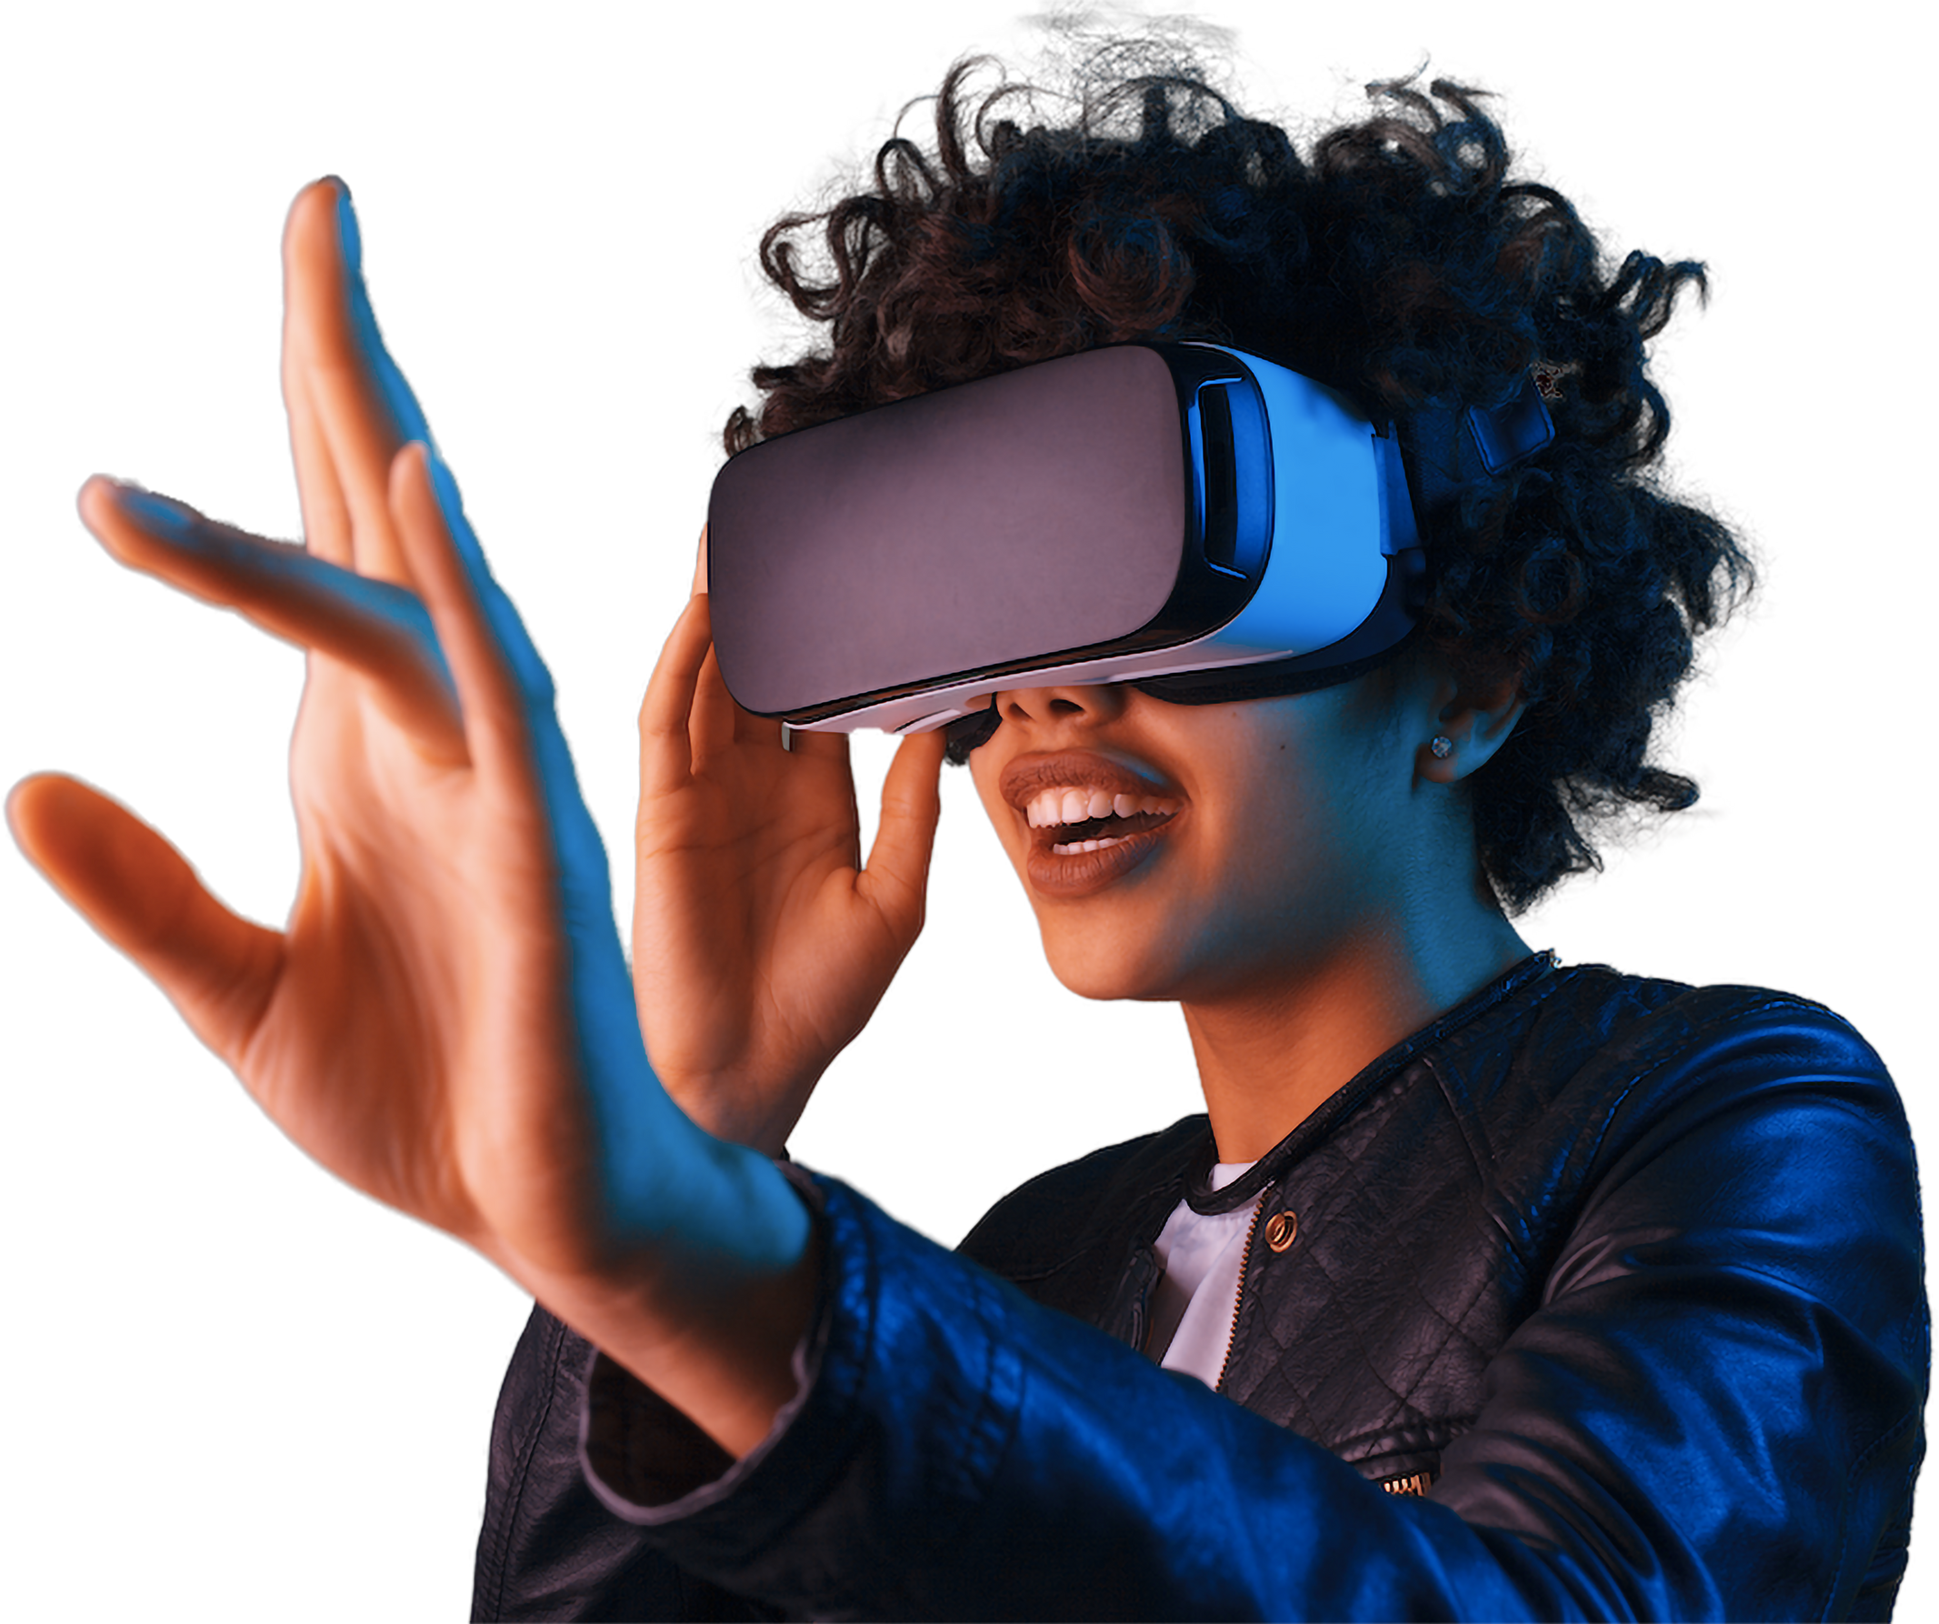

Types of Artificial Intelligence
Understanding the Categories of AI
WWW.REALLYGREATSITE.COM

Slide 2
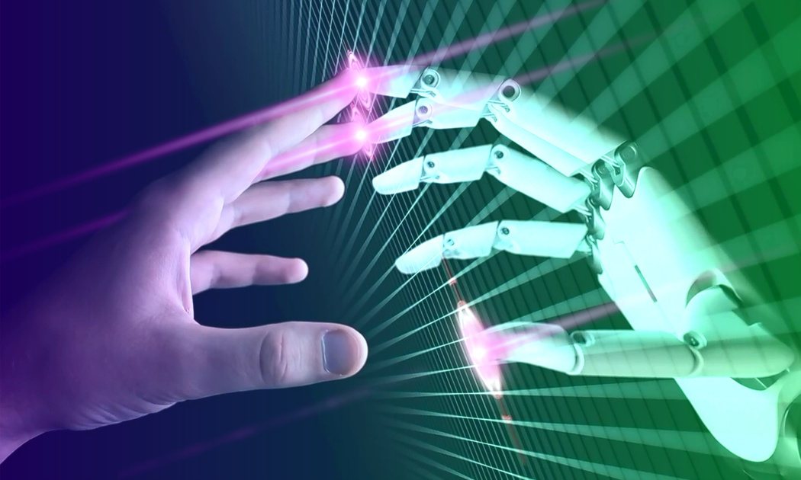
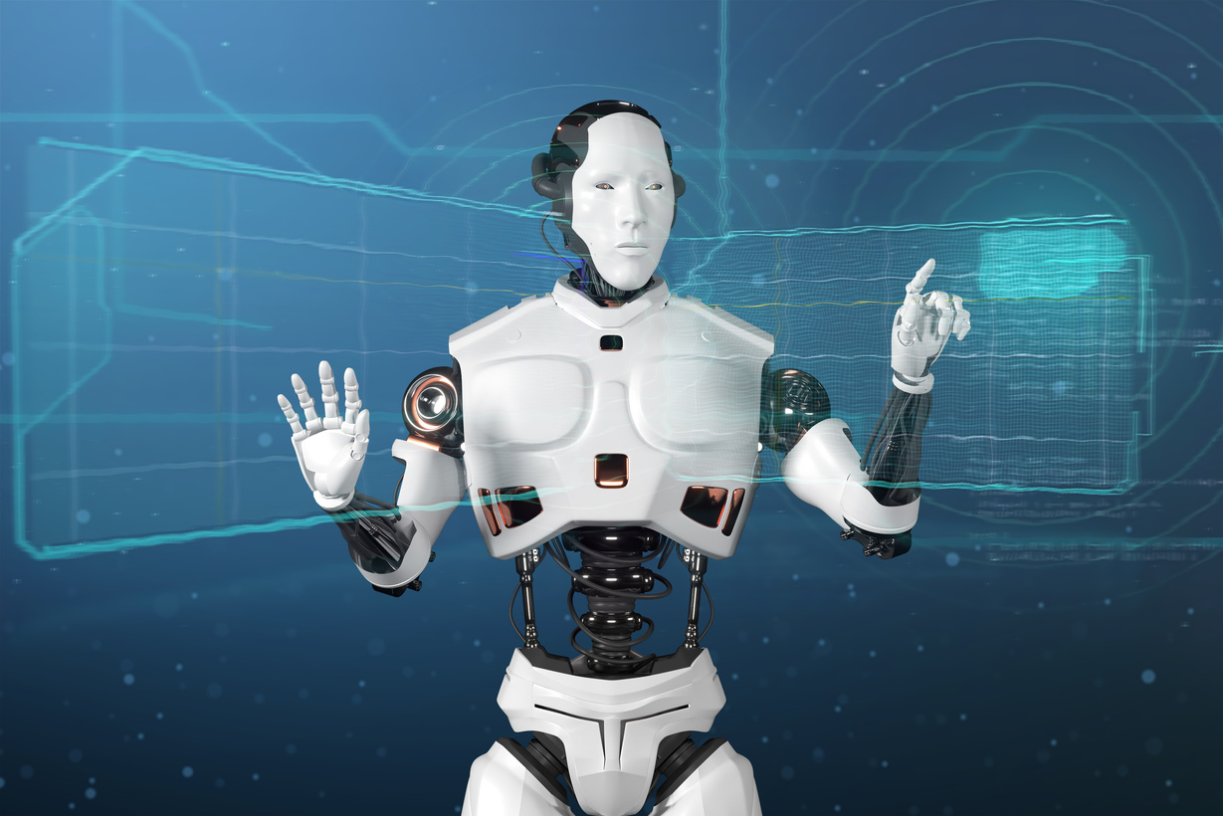
What is AI ?
Artificial Intelligence (AI) refers to the ability of machines to simulate human intelligence. AI enables computers and systems to perform tasks that typically require human intelligence, such as learning, reasoning, problem-solving, perception, and decision-making.
Key Features of AI:
Learning – AI can learn from data (Machine Learning).
Reasoning – AI can analyze situations and make decisions.
Problem-Solving – AI finds solutions to complex problems.
Perception – AI can process images, speech, and text.
Automation – AI automates tasks, reducing human effort.

Slide 3
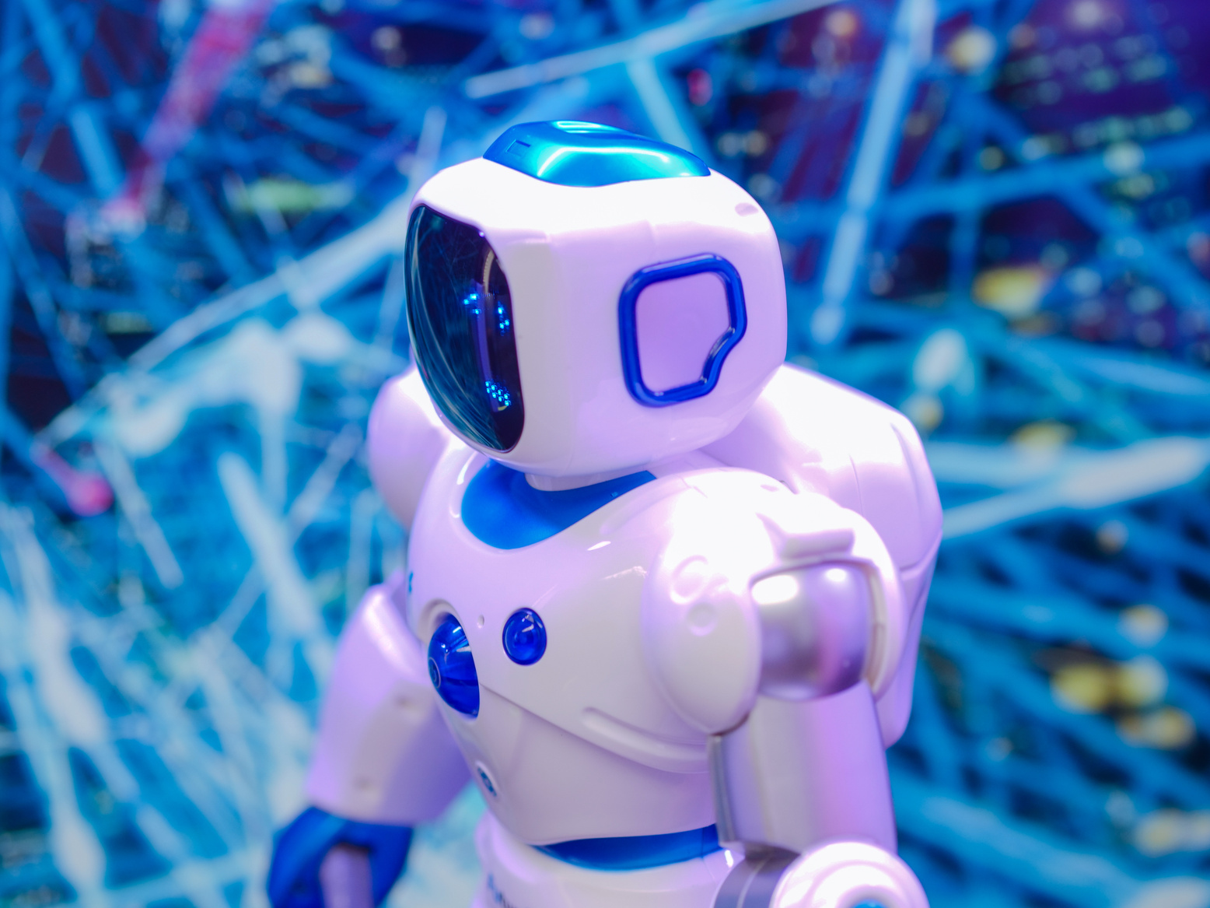
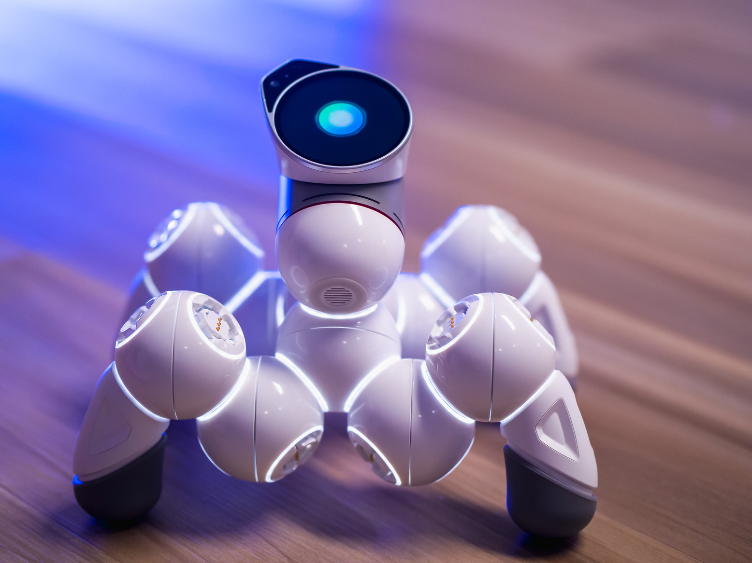

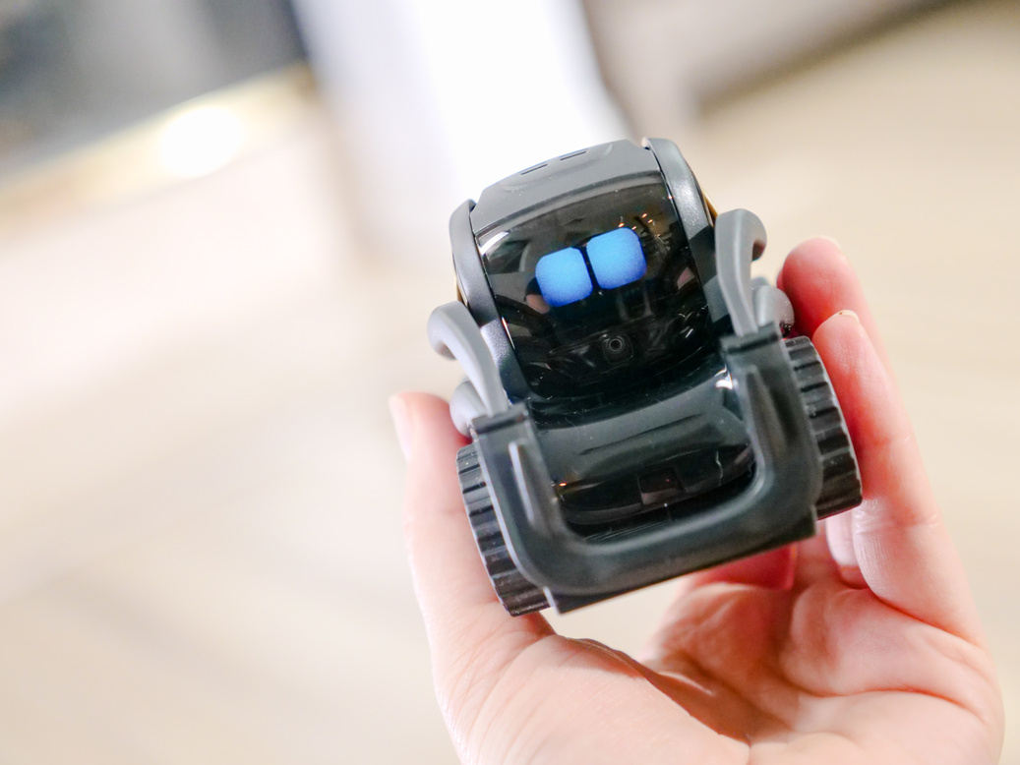
Classification of AI
AI is classified in two ways:
1
Based on Capabilities (How intelligent AI is)
2
Based on Functionality (How AI works)
WWW.REALLYGREATSITE.COM

Slide 4
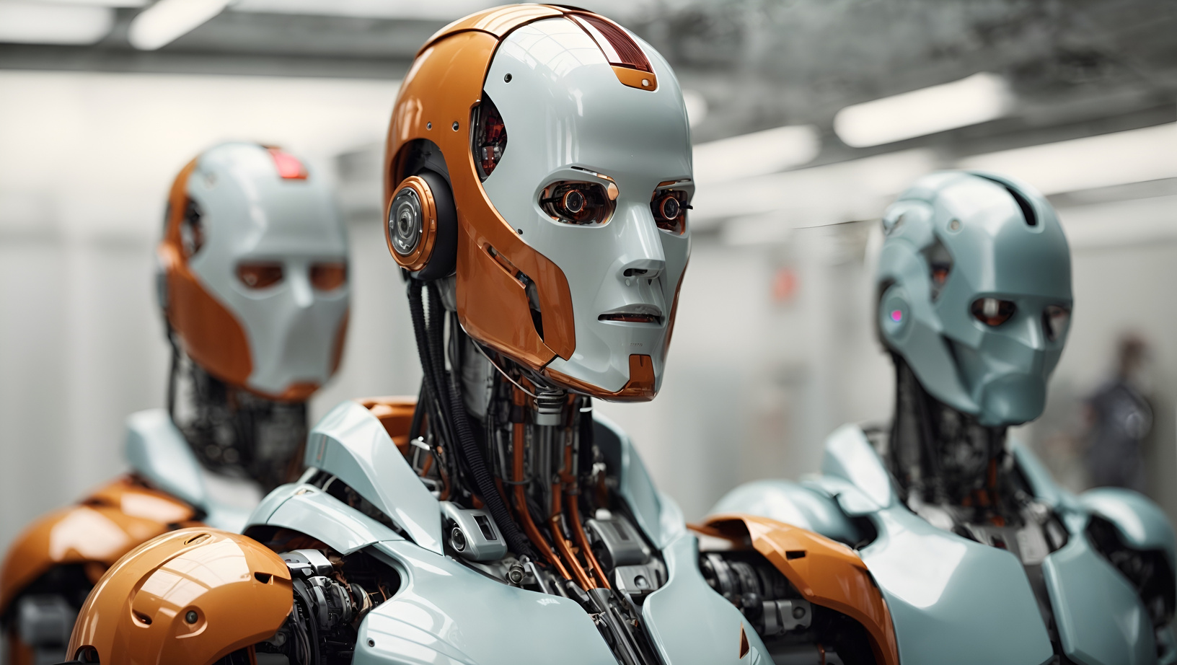
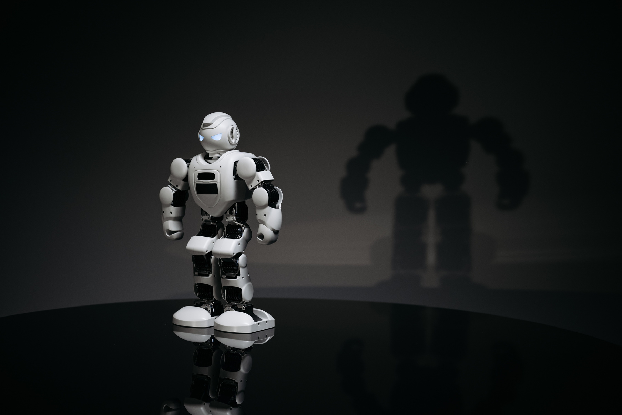
Types of AI by Capability
Overview: Three main types based on what AI can do.
Narrow AI (Weak AI)
General AI (Strong AI)
Superintelligent AI
1
2
3

Slide 5

Narrow AI (Weak AI)
Definition: AI designed for specific tasks.
Characteristics:
1). Limited scope, no general understanding.
2). Most common type today.
Examples:
1) Virtual assistants (Siri, Alexa).
2) Recommendation systems (Netflix, Spotify).
3) Image recognition (e.g., facial recognition).

Slide 6
General AI (Strong AI)
Definition: AI with human-like intelligence.
Characteristics:
1). Can perform any intellectual task a human can.
2). Adapts to new situations without reprogramming
Examples:
Sci-fi concepts (e.g., JARVIS from Iron Man).

Slide 7

Superintelligent AI
Definition: AI surpassing human intelligence.
Characteristics:
1). Hypothetical future stage.
2). Excels in creativity, problem-solving,
and decision-making.
Examples:
Speculative (e.g., Skynet from Terminator).

Slide 8
Types of AI by Functionality
Overview: Four types based on how AI operates
Reactive Machines
Limited Memory
Theory of Mind
Self-Aware AI
1
2
3
4

Slide 9
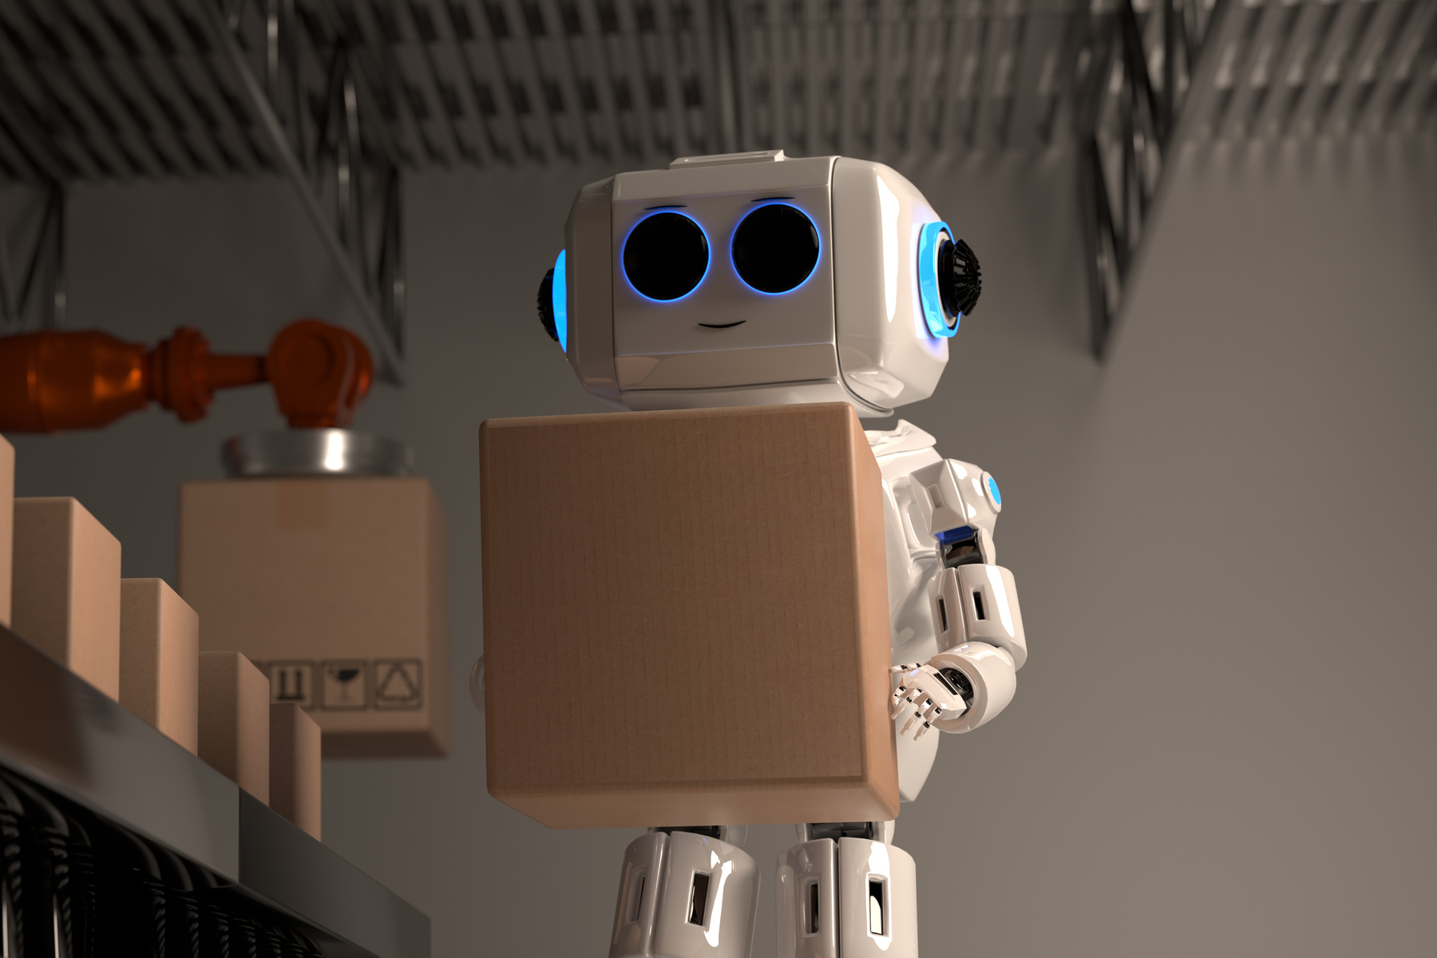
Reactive Machines
Definition: Basic AI with no memory or learning.
Characteristics:
1). Responds to current input only.
2). No past or future awareness.
Examples:
1). IBM’s Deep Blue (chess-playing AI).
2). Simple chatbots with fixed responses.

Slide 10

Limited Memory
Definition: AI that uses past data to improve.
Characteristics:
1). Temporary memory for decision-making.
2). Most modern AI falls here.
Examples:
1). Self-driving cars (learning from road data).
2). Predictive text on smartphones.

Slide 11
Theory of Mind
Definition: AI understanding emotions and intentions.
Characteristics:
1). Recognizes human mental states.
2). Still in development.
Examples:
1). Advanced social robots (future applications).
2). Emotional AI in customer service (emerging).

Slide 12


Self-Aware AI
Definition: AI with consciousness and self-awareness.
Characteristics:
1). Understands its own existence.
2). Purely theoretical at this stage.
Examples:
Sci-fi scenarios (e.g., HAL 9000 from 2001: A Space Odyssey).

Slide 13

Conclusion
AI RANGES FROM SIMPLE TASK-SPECIFIC SYSTEMS TO HYPOTHETICAL SUPERINTELLIGENCE.

